Slide 1

U.S. USED CAR
Data Analysis
-- Under the guidance of --
Dr. Jongwook Woo

Slide 2






GROUP 2 – Team
Vijay
Muthupillai
Savita
Yadav
Heta
Parekh
Sonam
Suryawanshi
Priya M R

Slide 3
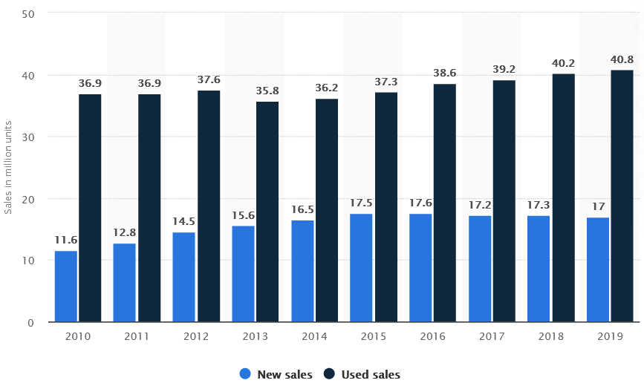


INTRODUCTION
In 2019, Used Cars sales in US was around 40.8 million, which was 240% more than new car sales (17 million).
The most convincing reason to buy a Used car rather than a brand-new one is depreciation, since Cars are considered depreciating assets and Negative Equity. New cars typically lose around 30 per cent of their value in the first three years. As a result, it's possible to save a lot of money on a newish second-hand car.
CarGurus which is based in Cambridge (MA), is an automotive shopping website that assists users in comparing local listings for used and new cars and contacting sellers. Dealers advertise on this site, and CarGurus connect dealers and consumers by putting inventory on the site.
Buyers have a different set of expectations when it comes to Used Car purchase, than a New Car. Some of the key factors are Accident History, Body type, Price range, Feature list, Seller Ratings, etc.
And so it’s very important for both Dealers and Buyers to know the outcome of various data Analytics so that Dealers can scheme their pricing and promotion strategy and Users can take an Informed decision before their used car purchase.

Slide 4
DATASET Info
Dataset: https://www.kaggle.com/ananaymital/us-used-cars-dataset
Products reviewed between: 2006 to 2020 are analyzed
Countries considered: U.S.A
File Size: 9.29 GB
Number of Files: 1
File Format: CSV (Comma Separated Values)
Total no. of product reviews: 3.0 million

Slide 5
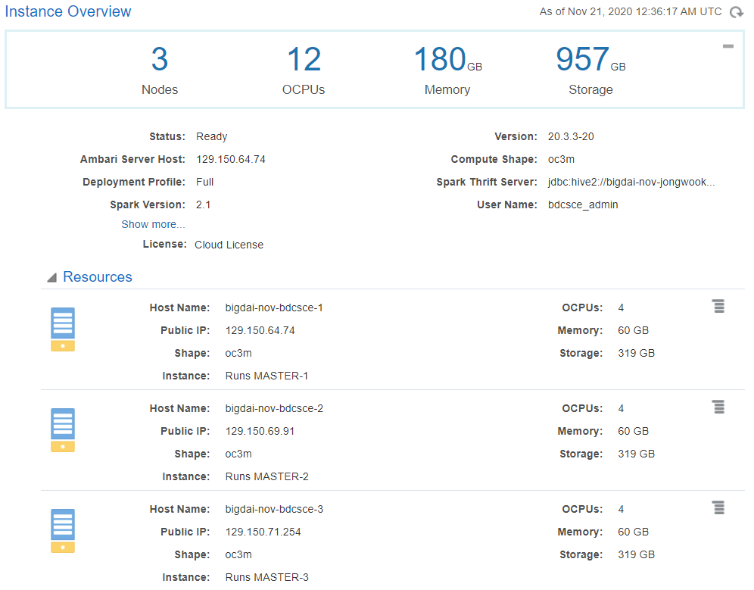
Oracle BDCE - CLUSTER Details

Slide 6
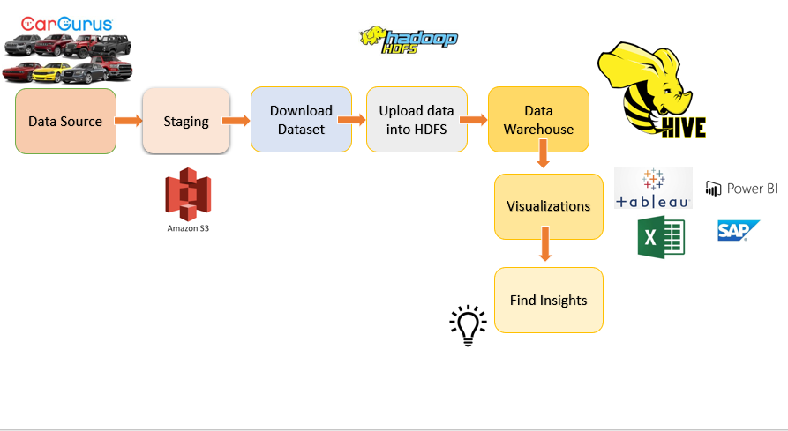
Architecture

Slide 7


Slide 8
1. Total Used cars based on body type
Analysis:
This analysis is intended to find out the composition mix of Used Cars by body type in the inventory of 3 million used cars in CarGurus.
Inference:
SUV / Crossovers dominate the inventory with close to 50% share which was expected as most Americans prefer bigger cars. However, the surprising data point to me is the higher Pickup Truck ratio than the Minivans. Offline analysis revealed that most American families in towns, farmlands and suburbs own Pickup Trucks for their day to day activities than the Minivan. That was an Interesting finding..
QUERY:
CREATE TABLE IF NOT EXISTS count_by_bodytype ROW FORMAT DELIMITED FIELDS TERMINATED BY ":" STORED AS TEXTFILE LOCATION "/user/vmuthup/GP2TermProject/bodytype" AS select body_type as BodyType, count(vin) as total from cargurus_usedcars group by body_type having count(vin) > 100 and trim(body_type) != '' and body_type is NOT NULL order by body_type;

Slide 9
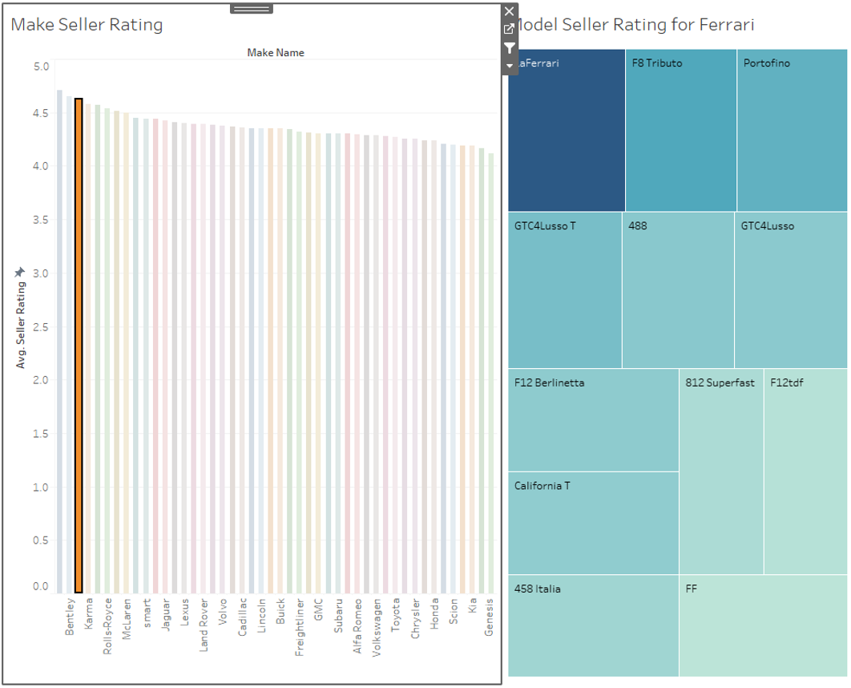
2. Seller rating of car brand and its models

Slide 10
2. Seller rating of car brand and its models
Analysis:
Analyzed the seller rating of all car brands and its’ models. The top 15 car makers having highest seller rating above 4.0 in last 5 years are 'Lotus', 'Bentley', 'Ferrari', 'Karma', 'Lamborghini', 'Rolls-Royce', 'Porsche', 'McLaren', 'Aston Martin', 'smart', 'MINI', 'Jaguar', 'Tesla', 'Lexus', 'Audi'.
The visualization signifies the importance of seller rating. From the data, it is implied that since the premium car brands and models provide better performance features and creature comfort, they fall in high seller rating.
QUERY:
CREATE EXTERNAL TABLE IF NOT EXISTS car_rating (make_name string, model_name string,year int, seller_rating string) ROW FORMAT DELIMITED FIELDS TERMINATED BY ',' STORED AS TEXTFILE LOCATION /user/hparekh2/GP2TermProject/tables/car_rating/';
INSERT OVERWRITE TABLE car_rating Select make_name, model_name, year, AVG(seller_rating) FROM cargurus_usedcars WHERE year >= 2015 and year <= 2020 GROUP BY make_name, model_name, year;.

Slide 11
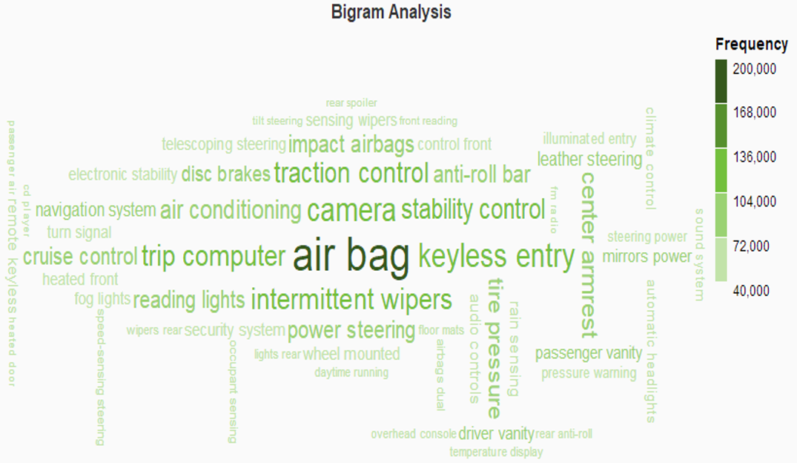
3. N-gram Analysis of Car Features

Slide 12
3. N-gram Analysis of Car Features
Analysis:
This tag cloud represents bi-gram analysis of the description for the cars feature lists. Among the features and latest technology – most are likely to be “Safety” (Airbag, Traction Control, Stability control, Security System) and “Comfort” (Keyless Entry, Air Conditioning, Back Camera, Cruise control, Navigation System) related.
QUERY:
Create table bigram_analysis(new_ar array<struct<ngram:array<string>, estfrequency:double>>);
INSERT OVERWRITE TABLE bigram_analysis Select context_ngrams(sentences(lower(description)), array(null,null),100)as bigram FROM cargurus_usedcars WHERE make_name IN ('Lotus','Bentley', 'Ferrari', 'Karma', 'Lamborghini', 'Rolls-Royce', 'Porsche', 'McLaren', 'Aston Martin', 'smart', 'MINI', 'Jaguar', 'Tesla', 'Lexus', 'Audi', 'Land Rover', 'Mercedes') AND year >= 2015;
Select Create table frequency_bigram (ngram string, estfrequency double) ROW FORMAT DELIMITED FIELDS TERMINATED BY ',' STORED AS TEXTFILE LOCATION '/user/hparekh2/GP2TermProject/tables/ngramAnalysis/';
Insert overwrite table frequency_bigram Select concat(X.ngram[0], ' ',X.ngram[1]) as bigram, X.estfrequency From bigram_analysis LATERAL VIEW explode(new_ar) Z as X;

Slide 13
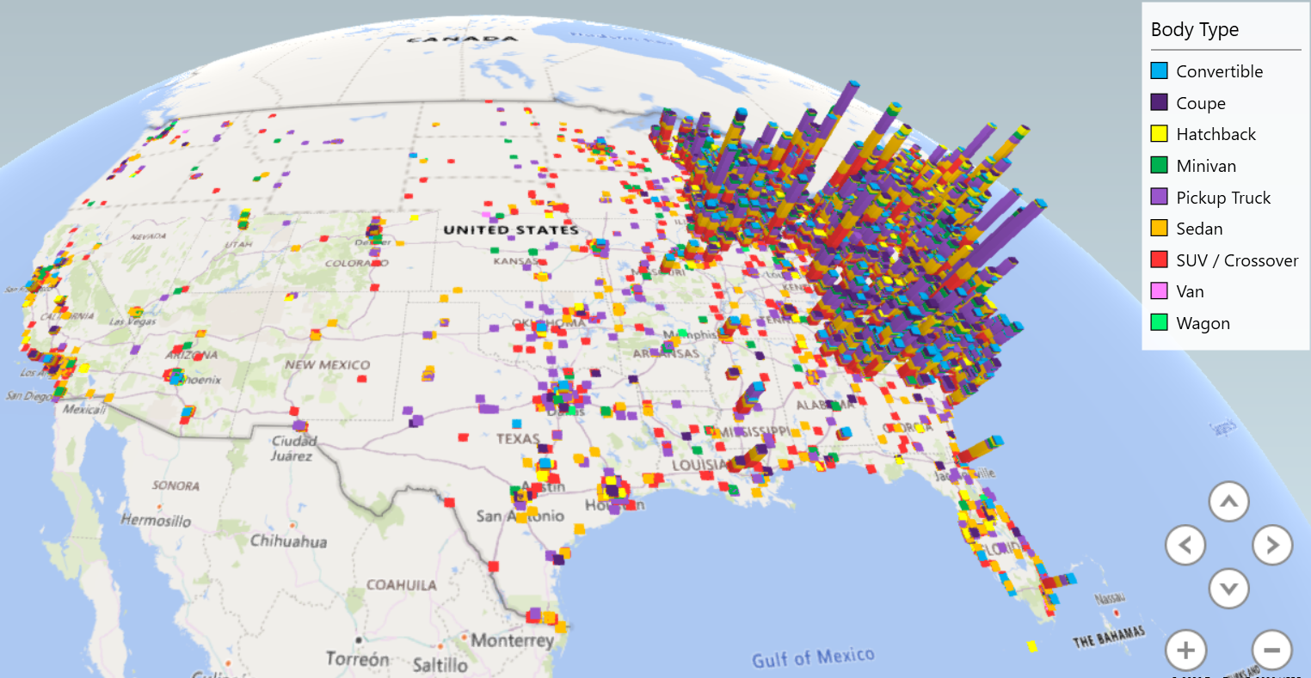
4. Inventory of cars by geospatial mapping
Analysis:
The geospatial map gives a realistic view of the data. It represents the most popular body styles across the US (SUVs, sedans, and pickup trucks). In general, the east coast of the US contains more listings than the west coast. SUVs dominate in the northeast region. Sedans and Pickups are popular on the east coast and parts of the Midwest regions like Michigan, Ohio, and Indiana. Overall, it will give the consumers a better idea of where to find reliable car dealers, and the dealers will have a view of where to bring their next car dealership in a particular region.
QUERY:
CREATE EXTERNAL TABLE bodystyle_region(body_type string, city string, latitude string, longitude string, make_name string, year string) ROW FORMAT DELIMITED FIELDS TERMINATED BY ',' STORED AS TEXTFILE LOCATION '/user/syadav5/GP2TermProject/tables/bodystyle_region/';
INSERT OVERWRITE TABLE bodystyle_region SELECT body_type, city, latitude, longitude, make_name, year from cargurus_usedcars where body_type != ' ' and year >= 2010 and year <= 2020 and year != ' ';

Slide 14
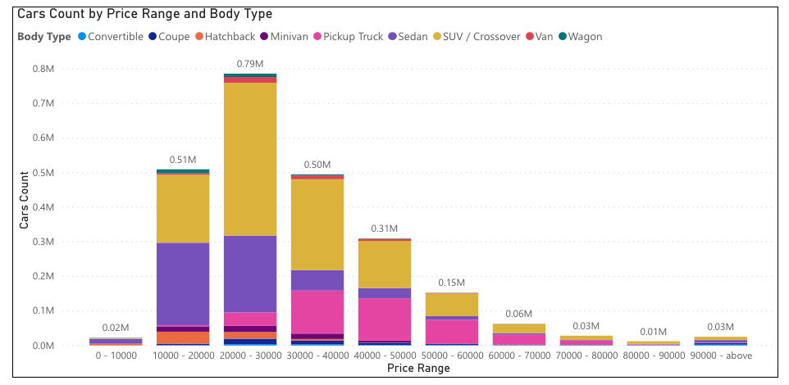
5. Cars based on body type and price range
Analysis:
The visualization represents the inventory of cars based on body type and price range for the past 5 years. The price range is distributed by every $10,000. Seems most Used car price is between 10k to 40k. And this price range, is dominated by Newest Used cars (e.g. Cars just out of 3 yr lease, etc). Also, since there are very few cars under 10K price range, it seems that both Dealers and buyers don’t prefer older used cars due to lack of confidence in their reliability.

Slide 15
5. Cars based on body type and price range
QUERY:
CREATE TABLE carsPriceRange AS select body_type, price , case when price > 0 and price < 10000 then '0 - 10000' when price > 10000 and price < 20000 then '10000 - 20000' when price > 20000 and price < 30000 then '20000 - 30000' when price > 30000 and price < 40000 then '30000 - 40000' when price > 40000 and price < 50000 then '40000 - 50000' when price > 50000 and price < 60000 then '50000 - 60000' when price > 60000 and price < 70000 then '60000 - 70000' when price > 70000 and price < 80000 then '70000 - 80000' when price > 80000 and price < 90000 then '80000 - 90000' else '90000 - above' end as price_range from cargurus_usedcars where body_type != '' and year >= 2015 and year <= 2020;.
CREATE EXTERNAL TABLE IF NOT EXISTS CarsPriceRangeByBodyType(price_range string, body_type string,Car_count string) ROW FORMAT DELIMITED FIELDS TERMINATED BY ',' STORED AS TEXTFILE LOCATION '/user/pramdas2/GP2TermProject/tables/CarsPriceRangeByBodyType/';
INSERT OVERWRITE TABLE CarsPriceRangeByBodyType select price_range,body_type,count(price_range) from carsPriceRange group by price_range,body_type order by price_range;

Slide 16
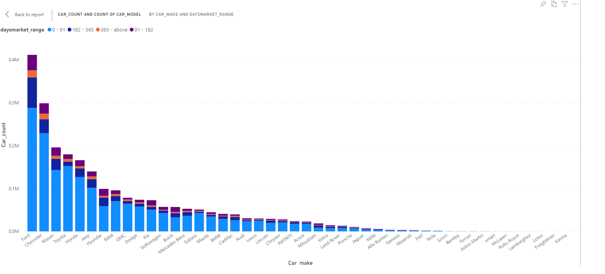
6. Cars that take longer time to sell

Slide 17
6. Cars that take longer time to sell
Analysis:
The Visualization represents how much time a car took to sell or how much days it was on the market. We have classified the range into 0-91 days, 91-182 days, 182-365 days and > 365 days The trend shows, there are less Toyota cars which are more than 91 days in the market whereas Ford has a substantial percentage of their cars beyond 91 days, 182 days, and even > 365 days. Similarly, large percentage of Buick and Hyundai cars takes more than 91 days to sell. This signifies that Toyota used cars sell faster in the market than FORD, Hyundai and Buick cars. This is a very useful visualization for the Dealers to see which car make takes longer time to sell so that they can take decisive action by offering discounts, promotions and rebates on specific brands and models to clear the inventory.
QUERY:
CREATE TABLE daysonmarketbydays AS select make_name,model_name, case when daysonmarket > 0 and daysonmarket < 91 then '0 - 91' when daysonmarket > 91 and daysonmarket < 182 then '91 - 182' when daysonmarket > 182 and daysonmarket < 365 then '182 - 365' else '365 - above' end as days_range from cargurus_usedcars_1 where body_type != '' and year >= 2015 and year <= 2020;
CREATE EXTERNAL TABLE IF NOT EXISTS car_market_days_range(make_name string,model_name string,days_range string ,Car_count string) ROW FORMAT DELIMITED FIELDS TERMINATED BY ',' STORED AS TEXTFILE LOCATION '/user/ssuryaw/GP2TermProject/tables/CarsdaysRangeByMake/';
INSERT OVERWRITE TABLE car_market_days_range select make_name,model_name,days_range,count(days_range) from daysonmarketbydays group by make_name,model_name,days_range order by days_range;

Slide 18
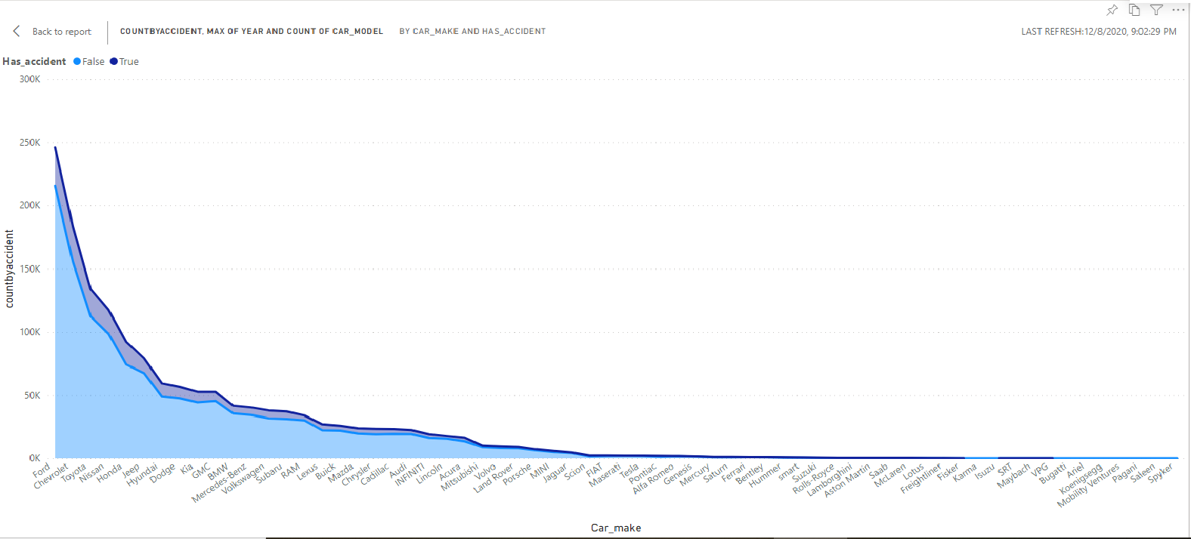
7. Inventory of cars having more accidents

Slide 19
7. Inventory of cars having more accidents
Analysis:
This visual data shows the ratio of Used Cars with and without accident history by car make. Accidents depends mostly on the driver's mindset and the conditions of infrastructure, weather, etc., irrespective of Car Brand from Ford to Ferrari. CarGurus has done a great job in keeping down the inventory of Used cars with accident history to low as 5-15%. This is a valuable information to buyers as they can shop around a wide range of car models of various trims and colors without accident history and can buy used cars confidently through CarGurus. Having more inventory of cars without Accident history increases the reliability of CarGurus dealers in the eyes of their buyers.
QUERY:
CREATE EXTERNAL TABLE IF NOT EXISTS car_has_accidents_model (make_name string, model_name string,year int, car_has_accidents string, has_accidents_count string) ROW FORMAT DELIMITED FIELDS TERMINATED BY ',' STORED AS TEXTFILE LOCATION '/user/ssuryaw/GP2TermProject/tables/CarsHasAccidentByMake/' ;
INSERT OVERWRITE TABLE car_has_accidents_model Select make_name, model_name, has_accidents, count(has_accidents) FROM cargurus_usedcars_1 WHERE year >= 2005 and year <= 2020 GROUP BY make_name, model_name, year , has_accidents;

Slide 20
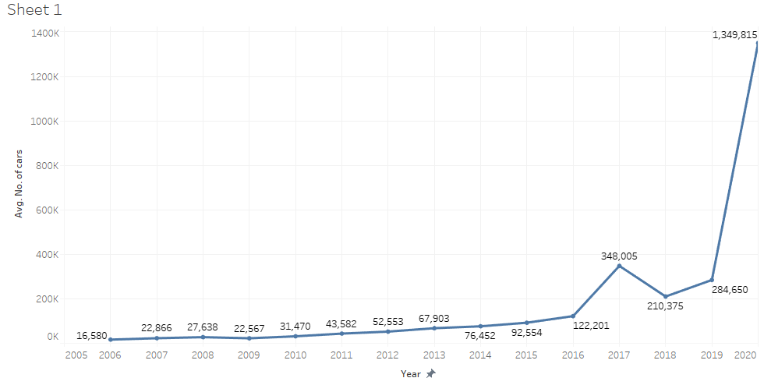
8. Inventory of cars by years
Analysis:
In the above visualization, it can be inferred that highest number of cars have been listed in the cargurus inventory for the year 2020. We can make an assumption here stating because of the Pandemic, many users wouldn’t feel the need for using the car and hence they sold it off to third party. I.e cargurus in this case.
QUERY:
CREATE EXTERNAL TABLE IF NOT EXISTS inventory_car (year int, no_of_cars int) ROW FORMAT DELIMITED FIELDS TERMINATED BY ',' STORED AS TEXTFILE LOCATION '/user/hparekh2/GP2TermProject/tables/inventory_car';
INSERT OVERWRITE TABLE inventory_car SELECT year, Count (*) FROM cargurus_usedcars WHERE year > 2005 GROUP BY year;

Slide 21
URLs and References
GitHub:
https://github.com/MRPriya/UsedCarSet
Amazon S3:
http://usedcardataset.s3.amazonaws.com/archive.zip
Dataset:
https://www.kaggle.com/ananaymital/us-used-cars-dataset
UsedCar vs NewCar trend graph (Introduction Slide):
https://www.statista.com/statistics/183713/value-of-us-passenger-cas-sales-and-leases-since-1990/

Slide 22
Thank You…!

